Slide 1
Story Sentiment Analysis
Presented By :
Pravesh Raikwar

Slide 2
Problem Statement
helps in understanding impact of narrative literature on mental health.
Emotional content of short story classification using the Arousal & Dominance norms.

Slide 3
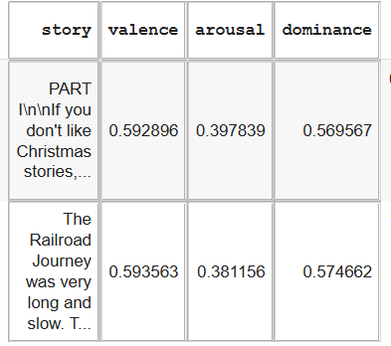
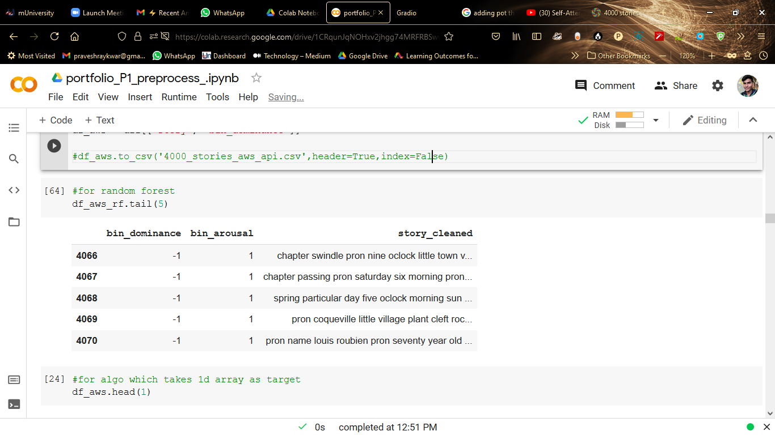
Dataset
Total Records/ Stories : 4071
Total features : 318
Relevant features : 3
link

Slide 4
Model Scores
AUC: 0.7703570177663444
Confusion Matrix :
[[269 117]
[ 67 362]]
Classification_Report :
precision recall f1-score support
-1 0.80 0.70 0.75 386
1 0.76 0.84 0.80 429
accuracy 0.77 815
macro avg 0.78 0.77 0.77 815
weighted avg 0.78 0.77 0.77 815

Slide 5
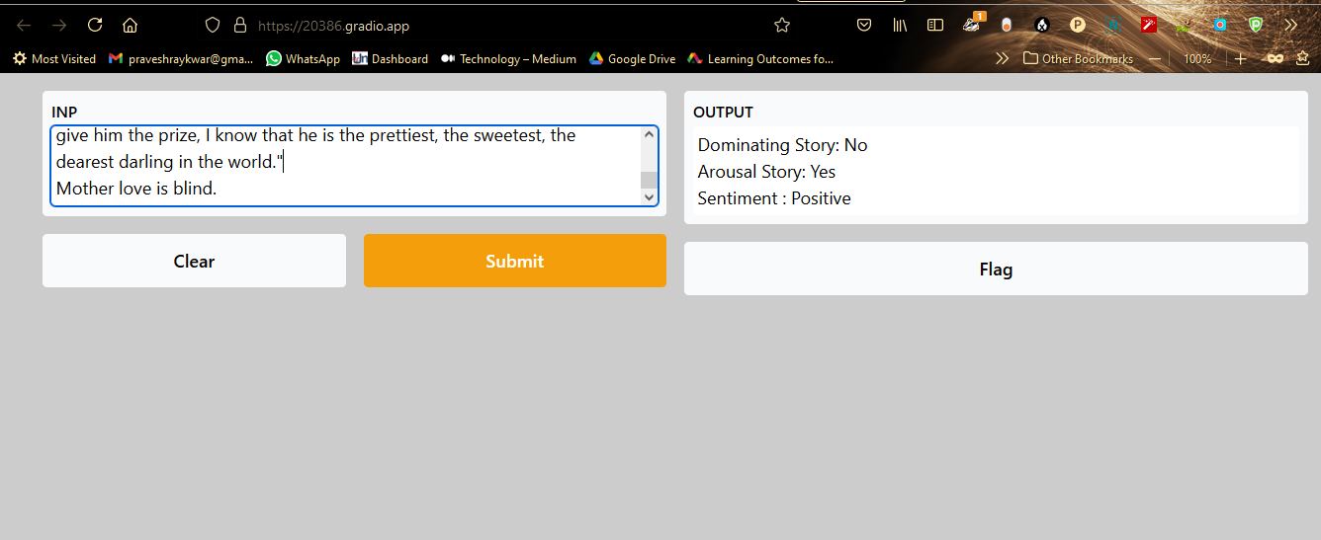
Deployment (using Gradio)

Slide 6
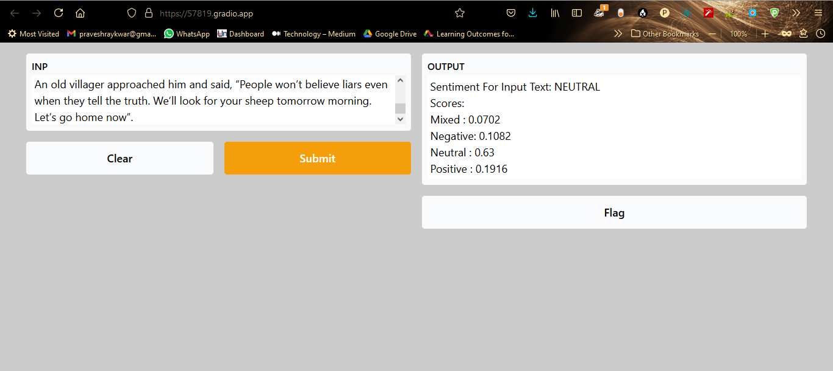

Slide 7
Thank You!!

